Slide 1
Digital Portfolio
STUDENT NAME: Harish R
REGISTER NO AND NMID: 1C67B7C3001E962903F42A4A9B55484F
DEPARTMENT: B.Sc Computer Science
COLLEGE: Nazareth college of arts and science ,(Madras University)

Slide 2
PROJECT TITLE
Interactive Digital Portfolio with Front End Development

Slide 3


AGENDA
Problem Statement
Project Overview
End Users
Tools and Technologies
Portfolio design and Layout
Features and Functionality
Results and Screenshots
Conclusion
Github Link
3/21/2024 Annual Review

Slide 4

PROBLEM STATEMENT
In today’s competitive job market, recruiters and hiring managers seek more than just resumes to evaluate candidates. Many developers struggle to present their skills, projects, and certifications in a way that is both accessible and engaging. Without a structured online portfolio, valuable achievements often remain unnoticed. A personal digital portfolio bridges this gap by providing a professional platform to showcase technical expertise, real-world projects, and career accomplishments in one place.

Slide 5

PROJECT OVERVIEW
Brief Summary: This project is a responsive and interactive digital portfolio developed to present my professional journey. It showcases technical expertise, academic achievements, and real-world projects in a well-structured format. The portfolio emphasizes both design and functionality to create a strong first impression for recruiters and collaborators.
Contents:
Home: Introduction and professional identity.
Skills: A comprehensive list of technical and programming skills.

Slide 6
Projects: Real-world applications and GitHub repositories demonstrating problem-solving and development ability.
Certificates: Verified achievements and course completions.
Contact: Direct communication channel for opportunities.
Social Profiles: Links to professional networks and coding platforms.
Main Idea: To provide recruiters, employers, and peers with a professional online presence that goes beyond a traditional resume. The portfolio serves as a centralized hub to evaluate my skills, creativity, and accomplishments, while reflecting my personal brand as a full-stack developer.

Slide 7

WHO ARE THE END USERS?
Recruiters & Hiring Managers: They can quickly review my skills, projects, and certificates to evaluate my suitability for job opportunities.
Employers & Clients: Companies or individuals looking for developers can assess my capabilities before offering roles or freelance projects.
Peers & Collaborators: Fellow students or developers can connect with me for collaboration, knowledge sharing, or networking.
Mentors & Educators: Professors, trainers, or career guides can use the portfolio to track my learning progress and achievements.

Slide 8

TOOLS AND TECHNIQUES
HTML5:
Used to design and structure the web pages with a clean and semantic layout. It forms the backbone of the portfolio by organizing sections like Home, Skills, Projects, and Contact.
CSS3 : Applied to style the website with colors, layouts, animations, and responsive design. Media queries were used to ensure the portfolio works smoothly on desktops, tablets, and mobiles.

Slide 9
JavaScript: Added dynamic behavior such as the typing effect in the hero section, theme toggle (dark/light mode), and form interactions. This makes the portfolio interactive and engaging.
Bootstrap: Utilized mainly for its responsive grid system and built-in utility classes. Bootstrap icons and components helped speed up development and maintain consistency in design.

Slide 10
Code Editors :
VS Code:Main development editor
Hoisting Platform:
Github : Control and repository management
(where the code it stored)
Github pages : Hoisting the portfolio website
AI:
Text corrections
Color ideas
Animation Ideas

Slide 11
POTFOLIO DESIGN AND LAYOUT
Title : Portfolio Website
By Harish
Role: Fullstack Developer
Website Overview:
A responsive personal portfolio showcasing:
About Me (Home)
Skills
Projects
Certificates
Contact
Social Links
Supports light / dark mode toggle
Optimized for desktop & mobile
11

Slide 12
Home / About Me:
Header with Navigation :(Home, Skills, Projects, Certificates, Contact)
Hero Section:
Greeting: "Hi, I’m Harish"
Typing effect for role/intro
Developer GIF for visual appeal
Responsive Hamburger Menu (for mobile view)
Skills:
Grid-based layout of skills:
Frontend: HTML, CSS, JavaScript, Bootstrap, React
Programming: C, C++, Python, Java

Slide 13
Backend & DB: Django, MySQL, MongoDB
Version Control: Git, GitHub
Icons used from Devicon for visual representation
Projects:
Grid Layout of project cards:
Fullstack Booking System → GitHub link
Fullstack CRUD-Application → GitHub link
Digital Portfolio → (Link placeholder)
Each card has Title + "View Project" Button
Certificates:
Certificates displayed in cards:
Meta Full Stack Developer → Completed (Score: 88.66%)
Microsoft AI & ML → In Progress
Option to View Certificate PDF

Slide 14
Contact:
Contact Form:
Input fields: Name, Email, Message
Submit button → Sends message
Status message shown dynamically
Encourages direct connection
Social Profiles :
Footer section with social icons:
GitHub
LinkedIn
Instagram
Email
Provides quick access to profiles

Slide 15
Responsive Layout:
Desktop View:
Horizontal navigation
Grid sections
Mobile View:
Collapsible hamburger menu
Stacked layout for skills, projects, and certificates
Scales properly with screen size

Slide 16
FEATURES AND FUNCTIONALITY
Navigation:
Fixed navigation bar with smooth scrolling
Responsive hamburger menu for mobile
Interactive UI:
Hover effects & animations on buttons, cards, and icons
Typing effect in hero section
Theme toggle (Light/Dark mode)
Projects Showcase:
Project cards with title, details, GitHub links
Support for project images/thumbnails
Interactive “View Project” buttons

Slide 17
Contact:
Contact form with input validation (name, email, message)
Dynamic confirmation message after submission
Certificates:
View/Download certificates in PDF
Progress status shown (Completed ✅ / In Progress ⏳)
Social Connectivity:
Direct links to GitHub, LinkedIn, Instagram, Email
Open in new tabs for quick access
Responsive Design:
Works seamlessly on desktop, tablet, and mobile
Layout adjusts using Grid & Flexbox

Slide 18
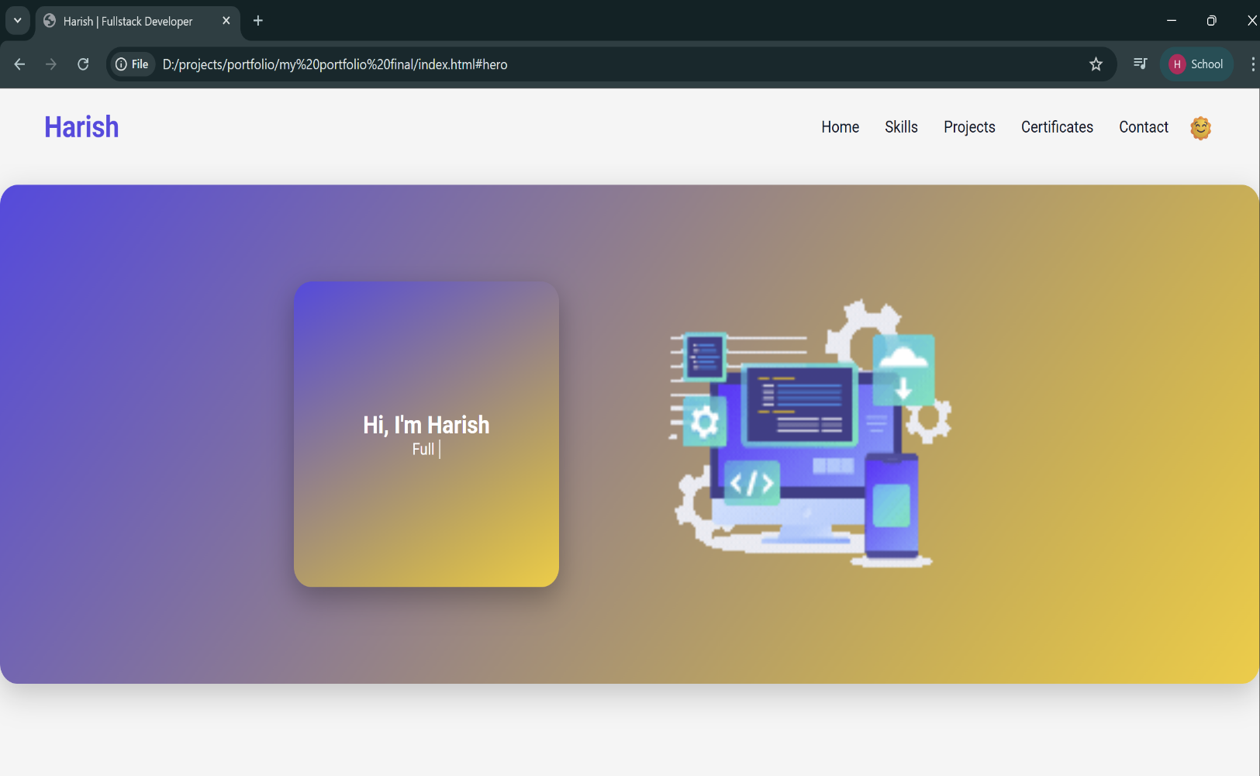
RESULTS AND SCREENSHOTS
Home:
18

Slide 19
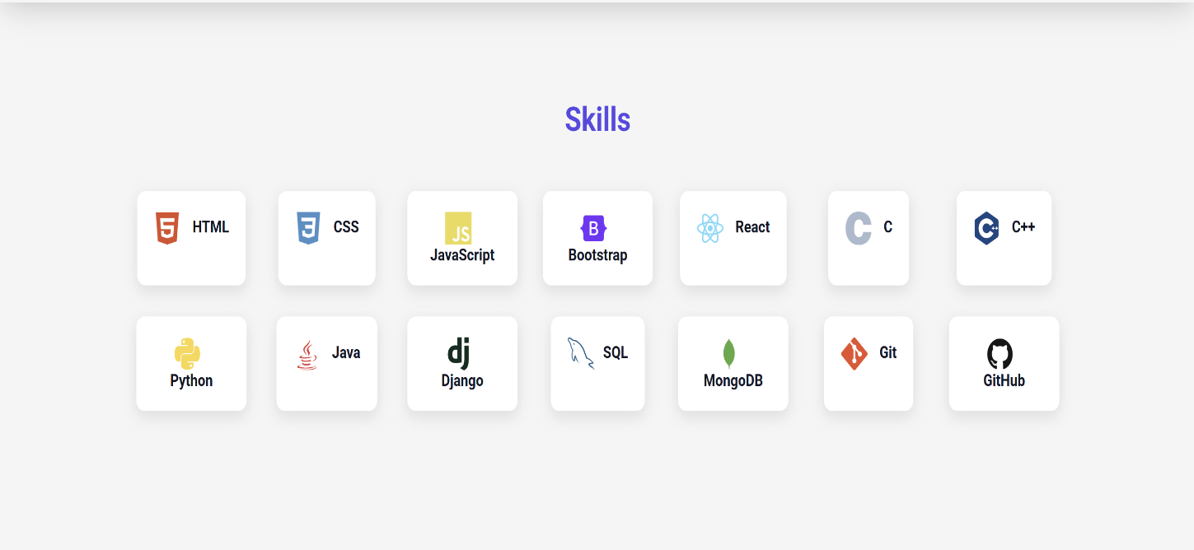
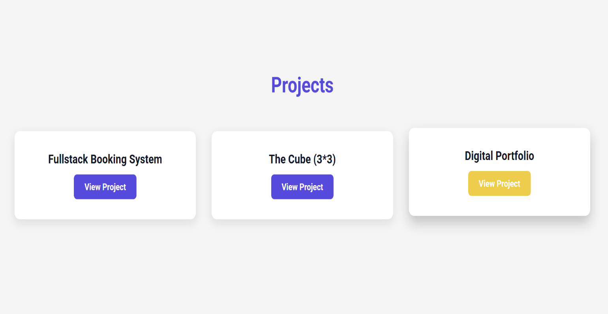
Skills:
Projects:

Slide 20
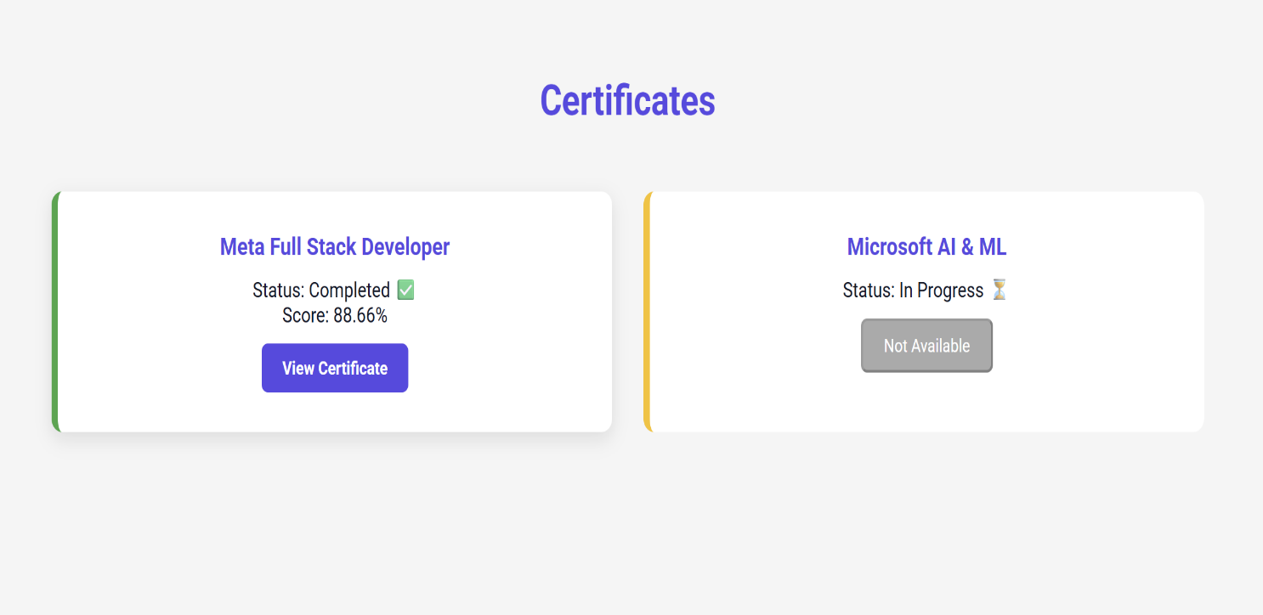
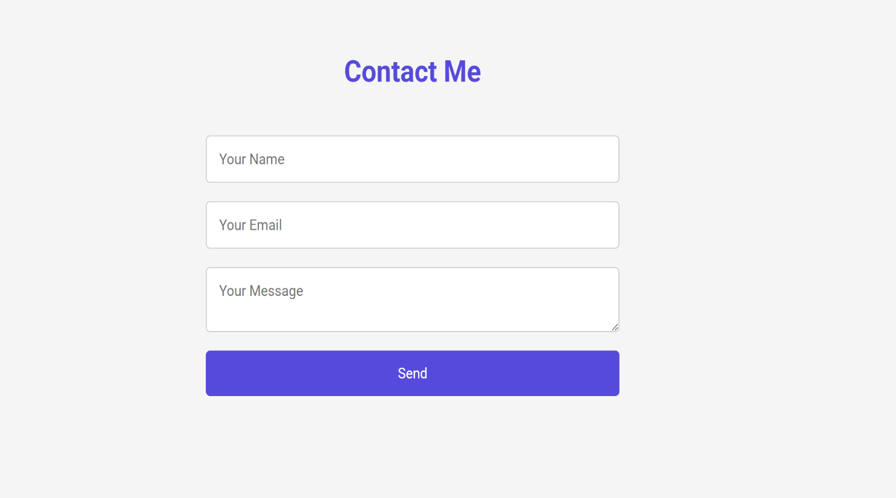
Certificates:
Contact:

Slide 21

Social Profiles:

Slide 22
CONCLUSION
Highlights of the Project:
Designed and developed a responsive portfolio website showcasing skills, projects, and certifications.
Implemented interactive features such as theme toggle, smooth scrolling, hover effects, and a typing animation.
Integrated GitHub project links, certificate downloads, and social media profiles for professional visibility.
Final Summary:
The portfolio serves as a digital resume and personal branding tool.
It provides a user-friendly and interactive interface for visitors to explore skills, achievements, and contact options.
22

Slide 23
Benefits to Society
Helps recruiters, peers, and collaborators quickly assess professional expertise.
Acts as a model for other developers/students to build their own online presence.
Contributes to a culture of digital self-representation and open-source sharing.
*********

